Slide 1
Research Data
Campus Research Storage (CRSP)
Philip Papadopoulos, Ph.D.
and all of RCIC
https://rcic.uci.edu/crsp/index.html

Slide 2
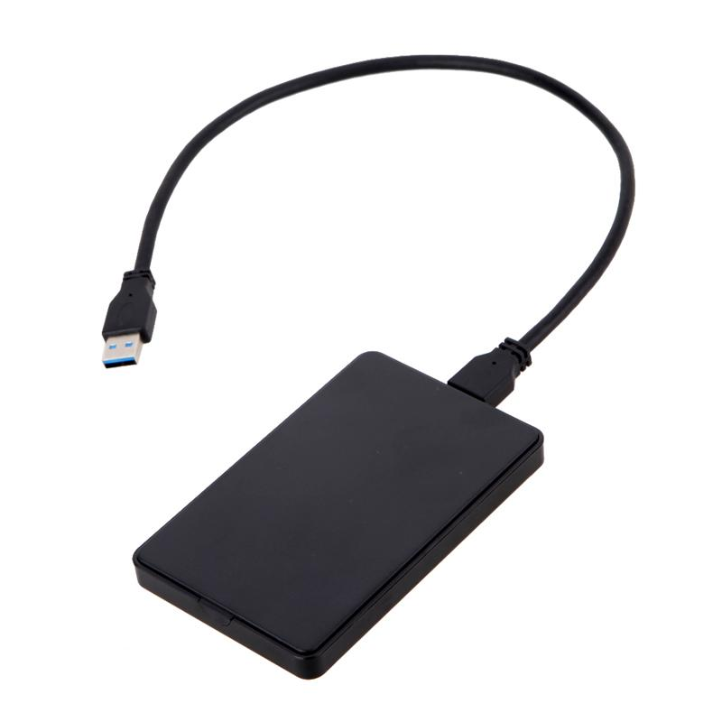
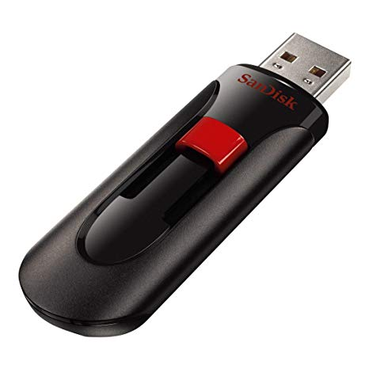


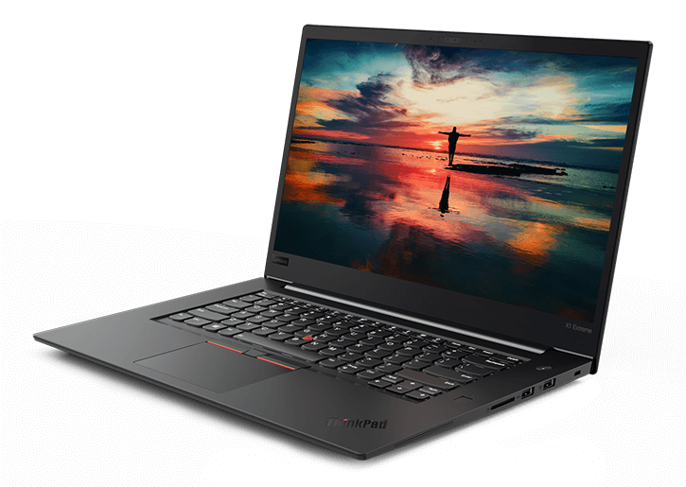
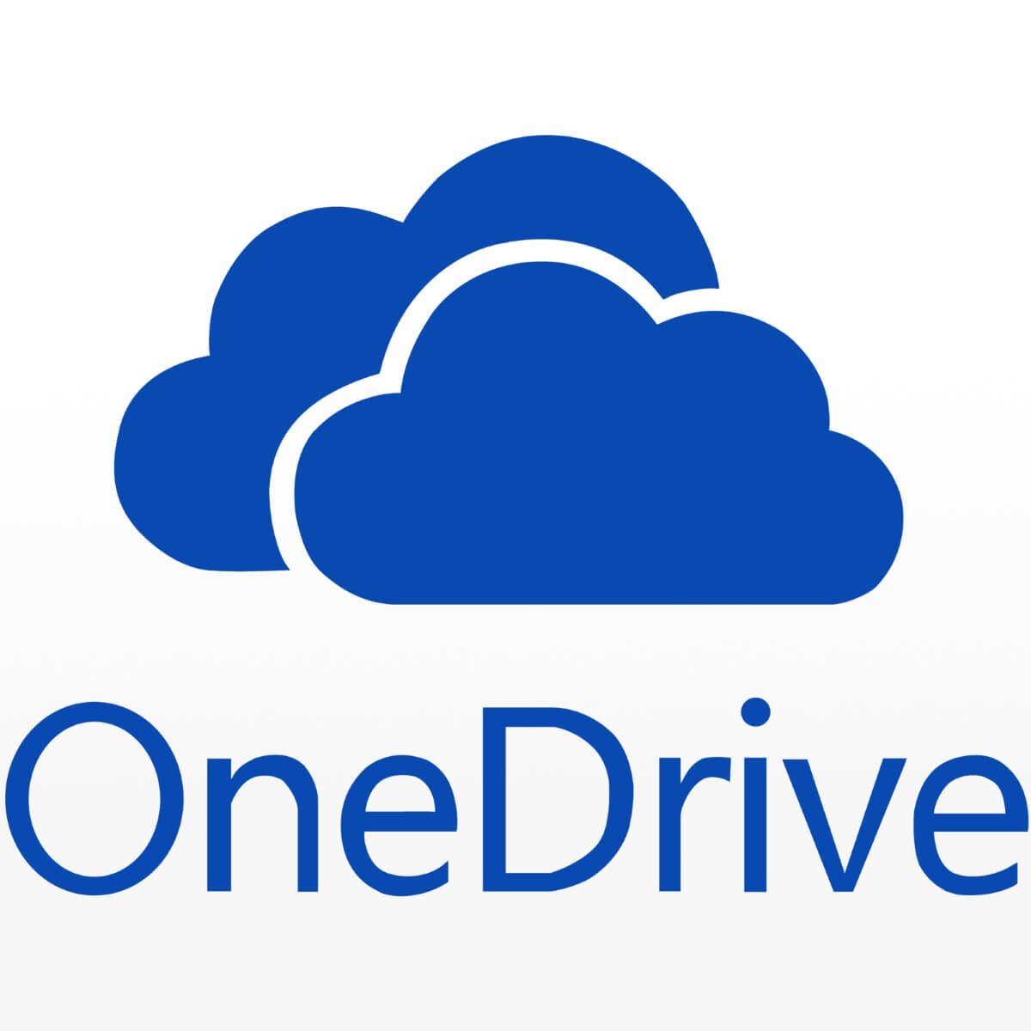

Where is your research data, today?
Significant Risk of Complete Data Loss
How do you work with data here?
There is no single “correct” answer for where to store your data
Observation: most campuses do not have a rational place to store and work with (large scale) research data
  Research data is literally “all over the place”

Slide 3
CRSP: Campus Research Storage Pool
Goals/Drivers
Provide a common place where faculty and their students/researchers can easily store and work with research data
Highly-reliable with close to 100% availability
Directly accessible from:
  Laptops and Desktops
  Scalable analysis clusters (e.g. HPC)
  Instruments and other lab equipment
  Web portal
No-cost, baseline space allocation. Reasonable cost to scale

Slide 4
CRSP: Driving Vision
Vision – provide an enterprise class data facility to significantly improve UCI’s stewardship of digital research data
  Most research data isn’t FAIR (Findable, Accessible, Interoperable, Reusable)
    CRSP is the first step by creating a storage facility (accessibility, interoperability)
    Low cost to researchers provides incentive to migrate data from “USB disks-on-a-shelf” to an enterprise facility
    Complement commercial cloud storage

Slide 5
The BLUF (Bottom Line Up Front)
No-cost storage space (1TB) per faculty member
Space apportioned into two different areas
  Private Area ( not-shareable)
  Lab Area
    Shareable with specific users (Requires UCNetID)
    Intended to enable faculty to place their, student’s, postdoc’s data into a single drive
More space can be purchased at $60/TB/Year via recharge
Access via: Webdrive (Mac/PC), simple web browser, sshfs (linux), rsync, sftp, and/or direct NFS from HPC
All data is immediately replicated in two on-campus data centers
Most faculty already have space allocated, contact us if your account is not available
For support: crsp-support@uci.edu

Slide 6
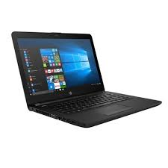
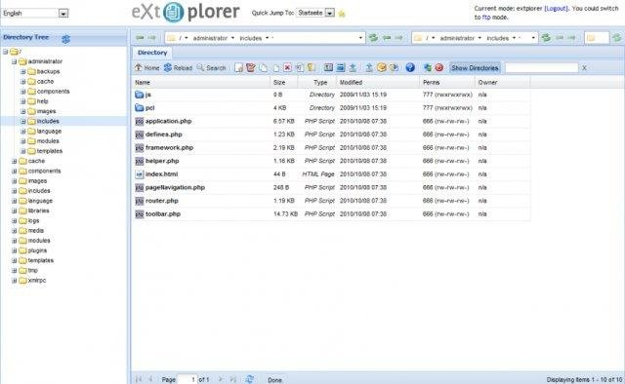
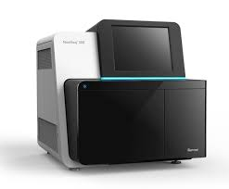
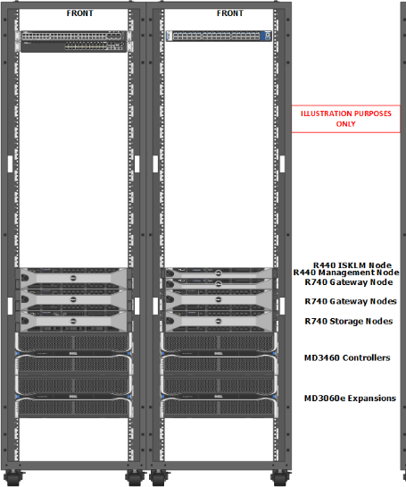
High-Level Tech Overview
CRSP
CRSP
UCI Network
Appears like “local disk” or file system
Must be on UCI network (or VPN) for access
Data is synchronously replicated across two centers
Available even if an entire data center is down
More technical details later in talk
OIT Datacenter
ICS Datacenter

Slide 7
Can any research data be stored here?
CRSP must not be used to store personally-identifiable information that would fall under guidelines such as FERPA (e.g. Student data), and HIPAA (health-care data). If you are unsure if CRSP is suitable for your data, please refer to general guidance for data security provided by the UCI Office of Research
Please note – because there are features of CRSP (e.g. data encryption at rest) that are already present, this statement may be relaxed in the future.

Slide 8
Lab Area (Shared) and Private Area
CRSP Allocation (1TB @ no cost + PI-Purchased)
Lab Area
Private Area
PI decision on how to apportion space
Behaves “like a disk”
PI grants explicit access to others
  Examples of others: Students, Postdocs, UCI Faculty
Each grantee (UCNetID) has their own folder in this disk. By default, PI also has access to this folder
A “share” folder exists readable/writable by all who have been granted access
PI can limit how much of total disk each user can consume
Not intended for sharing with others
If you want to share folders, they need to be in a different area on CRSP

Slide 9
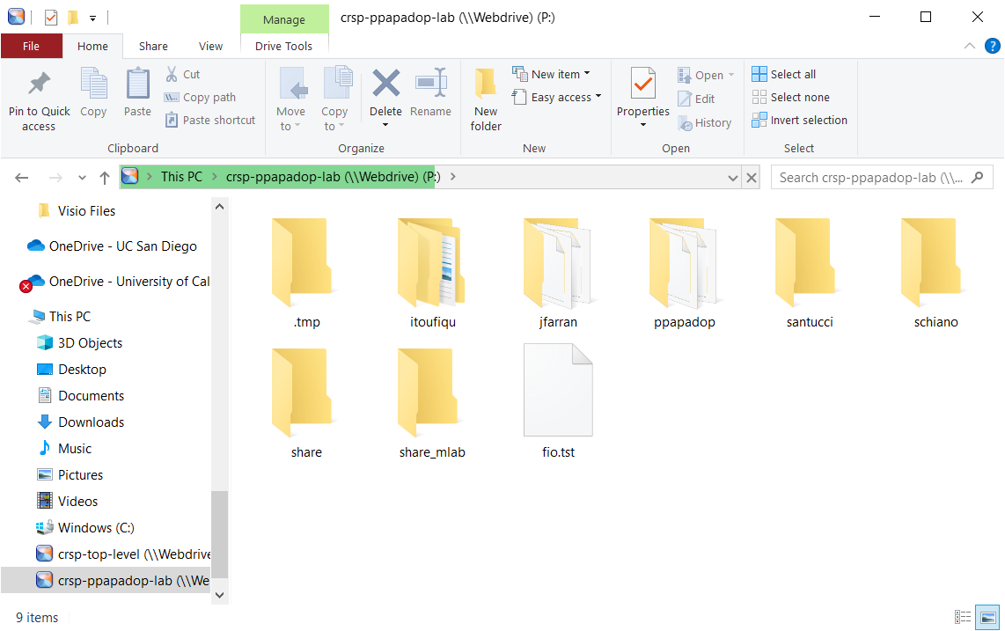
A Sample Lab - ppapadop
Per-User Folders
Shared Folder

Slide 10


Challenge: Multi-OS Support
CRSP is available from Linux, Mac, and Windows
These operating systems use fundamentally different methods for identifying users, granting access, defining and limiting sharing.
Use UNIX groups as the mechanism to define who can read/write files/folders
This lowest common denominator means
  Uniform access, no matter the OS
  Only so much flexibility

Slide 11

File visibility and ownership
ALL Files in a Lab are Readable by the PI
Files in per-student directory/folder are readable by the student and the PI
Files in the share folder are readable by everyone in the lab
When students/researchers leave (graduate), data is available to the PI
All files/folders have a group
PI Group
LAB Group
Students
Postdocs
Others
PI
Readable by Owner
And PI
Readable by Owner
And Entire Lab

Slide 12
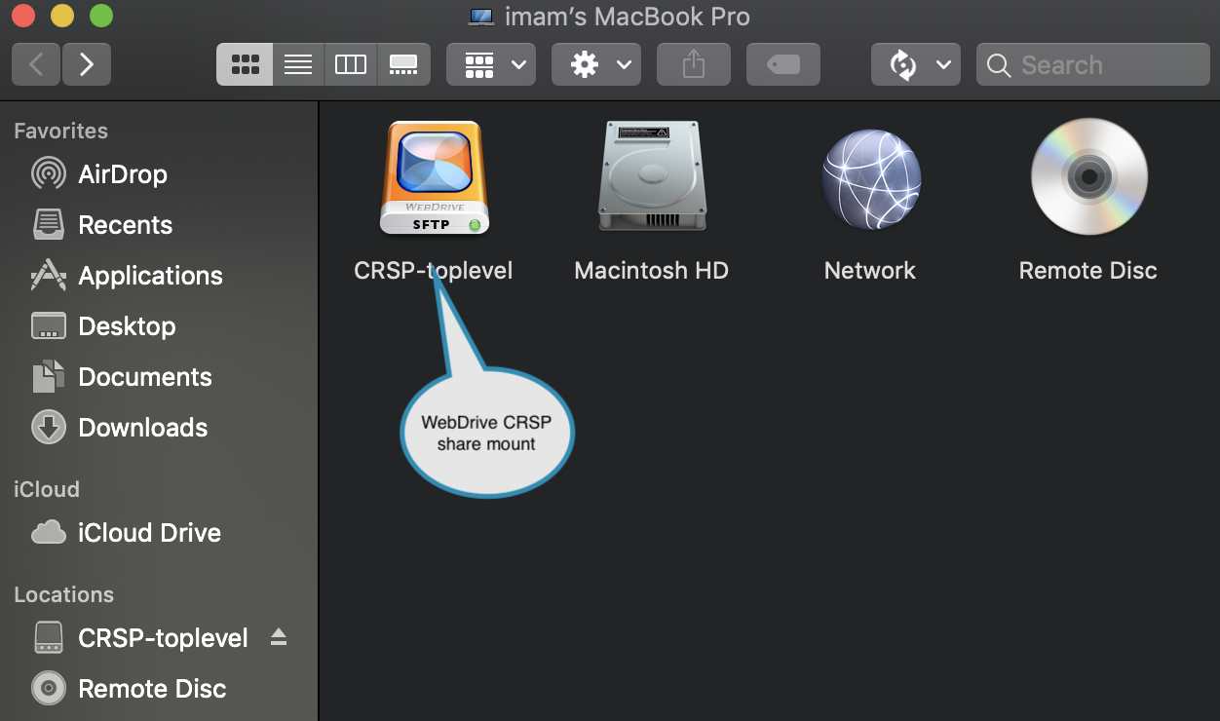
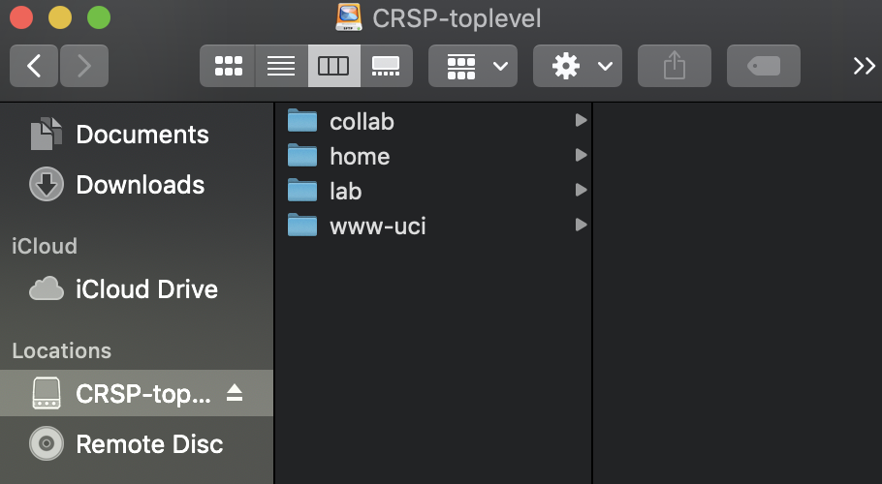
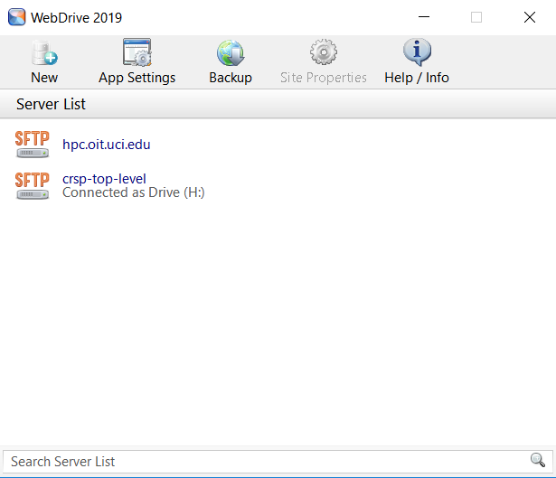
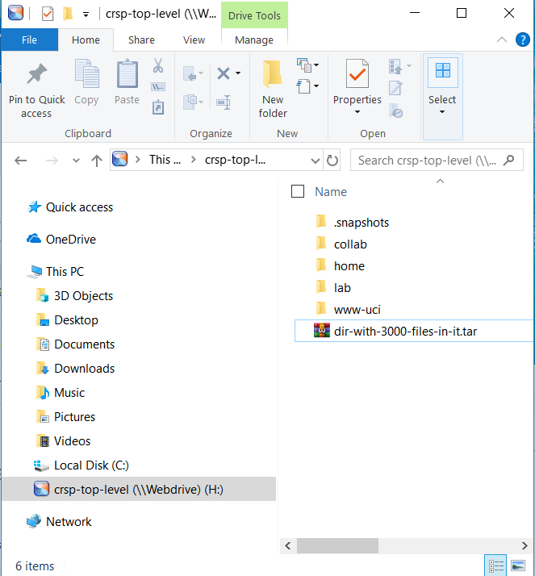
Gaining Access to CRSP (Desktop)
From Windows/Mac systems, and mobile devices
WebDrive
  A GUI tool for mapping CRSP shares (and many other protocols) as a drive letter or as a disk mount in ‘Finder’ for Mac
  Map as many shares as needed for CRSP
  Campus-wide license, available to everyone in the campus
  Access from mobile devices
WebDrive uses the SFTP (SSH file transfer protocol). Any software that supports this protocol can be used (e.g. CyberDuck, Filezilla, and others).
WebDrive for Mac
WebDrive for Mac
WebDrive for Windows
WebDrive for Windows

Slide 13
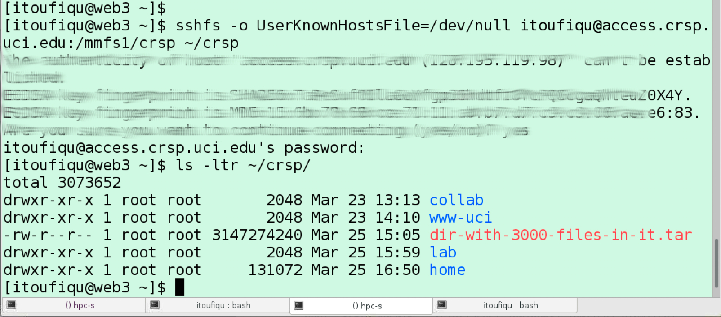
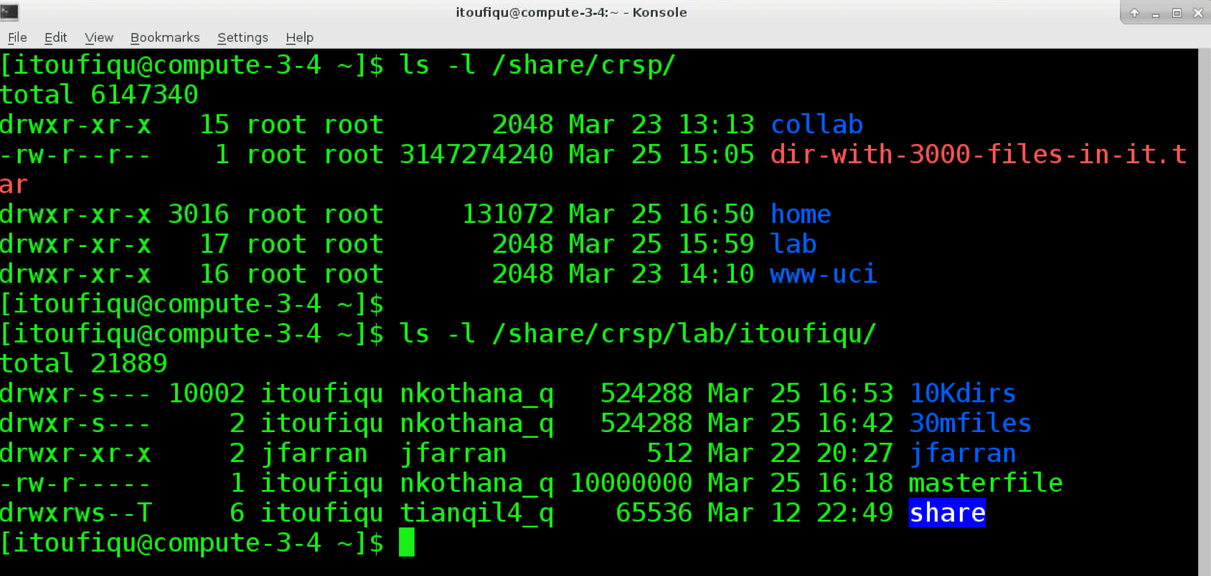
CRSP Access Methods(Linux)
From Linux systems -
SSHFS
  Command line tool for mounting remote file-system over SFTP
  Any remote directory mount is visible as a standard path in Linux system
  Available as a package in Linux distributions
  Installation and configuration instructions are available in CRSP site
CRSP sshfs
From HPC:
NFS
  All CRSP shares are accessible from HPC cluster
  Note: HPC went through a massive UID/GID migration to make this work. Thanks to Joseph Farran for doing this work with minimum disruption!
CRSP access from HPC (NFS)

Slide 14
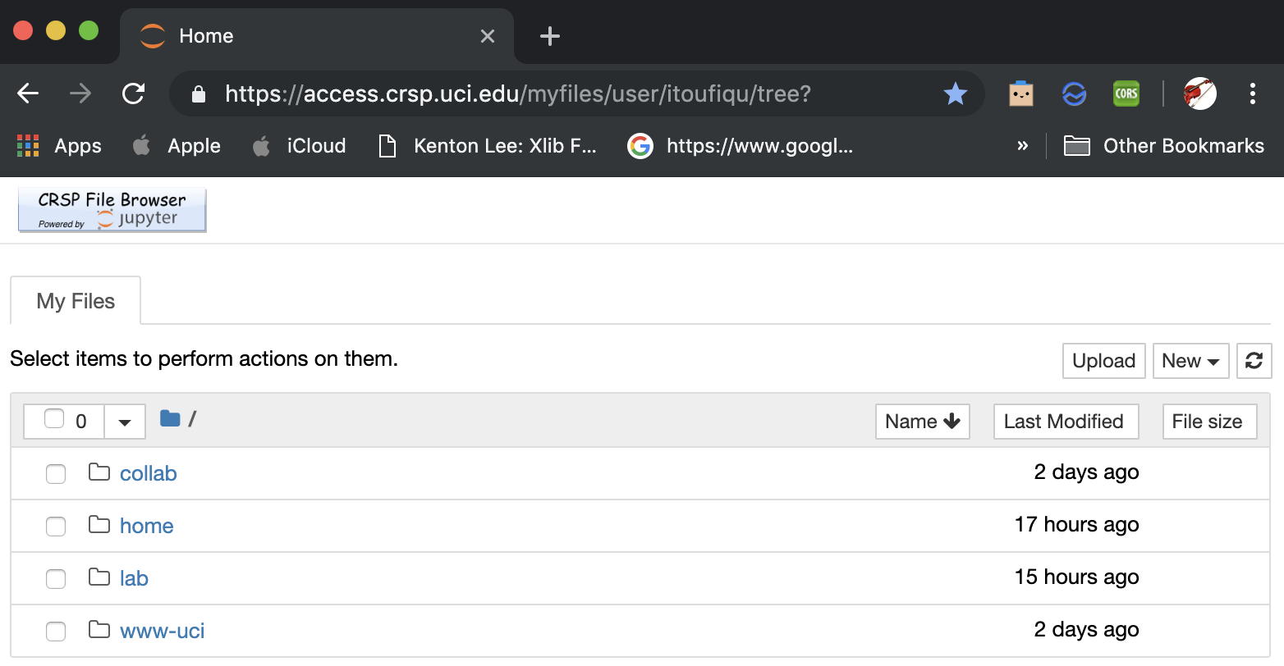
CRSP Access Methods (Web)
From web browser
CRSP Web-based Access
Web application for lightweight access, powered by Jupyter
Capability of upload, download files. Capability of in-browser editing for certain files
Single sign-on with UCI shibboleth authentication system, with UCINETID and password
Follows UNIX security models
CRSP web based access

Slide 15
Your One Stop for CRSP Support
Email: crsp-support@uci.edu
Access, issues, purchase of additional space, adding users
Web Page: https://rcic.uci.edu/crsp

Slide 16
Some feedback from users
How can we share with users outside of UCI?
  Can always sponsor an UCNetID, but that’s not very convenient
  Two additional possibilities
    Authenticated, read-only access. Use In-Common so that remote users could access selected areas using their home institution identies.
    Authenticate, read-write access. This is more difficult. Who owns the file locally? What’s the interface? Files stored this way – are they accessible via other CRSP mechanisms?
CRSP doesn’t work for our video editing, can it be fixed? Yes. The universal technology is SMB (Samba) shares. We’re sorting out authentication issues.
I have more than one group of students, can I have two different share areas under my lab? We have a way to do this, please email us.
Can the adding/removing UCNetIDs from my lab be self-service? Eventually.
Are there other storage options at RCIC? Yes.

Slide 17


Two Styles of Storage @ RCIC
CRSP
Available throughout campus network
Dual-Copy of data
Encrypted at Rest
7x24x365 support
Commercial Support
$$ ($60/TB/year)
Parallel File System
Available only on HPC Cluster(s)
Single-Copy of data
Not Encrypted at Rest
Best-effort availability (pretty good in practice)
$ ($100/TB/5 Years)

Slide 18
Some Technical Detail

Slide 19
CRSP building blocks
Purchased via RFP @ ~$1.2M
Hardware
  Enterprise-class server and storage hardware from Dell
  Enterprise-class networking hardware from Dell and Mellanox Technologies
File-System Software
  Enterprise scalable file system from IBM (IBM Spectrum Scale, aka GPFS)
Other Software
  Commercially-supported load balancer software from HAProxy Technologies
  Commercially-supported desktop application software from South River Technologies (WebDrive), for folder-on-the-desktop access in Windows, Mac systems
    Protocol is SFTP, can support sshfs(linux), FileZilla, CyberDuck, …
  Simple Web-browser access (adapted Jupyter Notebooks, open source)
Implemented by RCIC

Slide 20
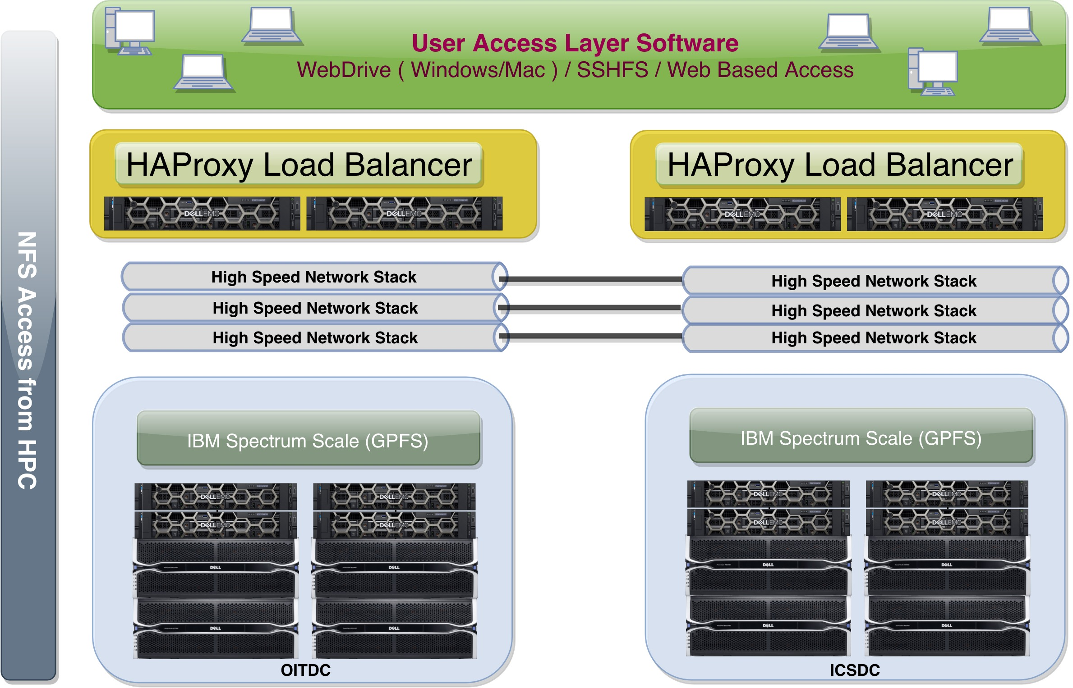
CRSP building blocks – Two Sites

Slide 21
Availability and Resiliency
High-Availability Hardware
Storage system hardware capable of sustaining up to full site outage, either in OIT Data Center (OITDC) or ICS Data Center (ICSDC)
Networking hardware capable of sustaining up to full site outage, either in OITDC and ICSDC
Enterprise Scalability and Resiliency
GPFS can support up to ~18PB capacity in a single namespace
Active-Active cluster can sustain up to three physical storage node failures
Dual active-active frontend HAProxy load balancers. Capable of almost seamlessly connecting users to the storage system from anywhere on the campus
Capable of highly granular storage system management, such as, granular quota management, file system usage analytics, adding/removing storage capacity without taking the system offline

Slide 22
How do I get started?
Faculty accounts are already created
  Submit requests to add students (eventually will be a self-help “portal”)
Web access to login:
  https://access.crsp.uci.edu/myfiles
Other access methods:
  https://rcic.uci.edu/crsp/howtos.html

Slide 23
Acknowledgements
From OIT
  Dana Roode
  Kazuto Okayasu
  Jessica Wu
  Jason Meyers
  Tyler Turley
  Ken Cooper
  Alexander Giesler
From ICS
  - Hans Wunsch
  - Du Tran
CRSP RFP Evaluation, architecture and implementation team
  - Allen Schiano, CRSP project manager (retired)
  - Nick Santucci, GreenPlanet cluster administration
  - Joseph Farran, HPC
  - Francisco Lopez, HPC
  - Harry Mangalam, HPC (retired)
  - Imam Toufique, HPC
  - Phil Papadopoulos, HPC
  - Peter Herring, Arcastream
Our special appreciation to RCIC executive committee and the Office of Research, for giving us the opportunity to serve all the researchers in UCI campus.

