Slide 1
Automating Business Processes with FileNet and Case Manager

Slide 2
Agenda
Case Manager Overview
Departments/Offices Using Case Manager
Demo: HR/PD Background Check Case Manager
Q&A

Slide 3
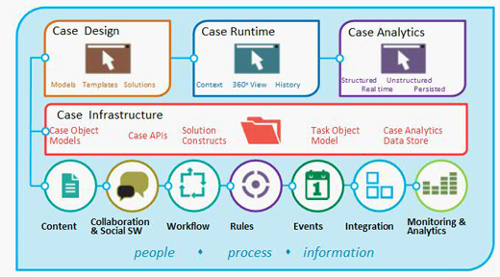
What is Case Manager?
Notes:
What is Case Manager? A Google search might show you something like this, which is a lot and might not make a lot of sense. But I think it’s good in showing how much Case Manager is capable of and just how much it is has to offer.

Slide 4
Case Manager - Overview
Reporting
Workflow
Content
Content
Data: employee information, etc.
Forms: requests, orders, etc.
Documents: PDFs, invoices, etc.
Notes
Workflow
In-baskets: for collaboration between roles
Tasks: based on business rules
Notifications/Reminders: reminders to complete tasks
Email: quickly send template emails
Reporting
Case Packager: quickly zip up you cases for sharing
IBM Cognos: use Cognos to run reports with the data in your cases
Built-in Widgets: graphs, history, etc.
Notes:
But I like to break up Case Manager a little simpler. Case Manager is three basic components working together in one package: Content, Workflow, and Reporting.
Content is all of your business content. Entry forms, documents, notes, and case data can all be streamlined together in one system.
Workflow is the business processes behind all of your content. Business rules

Slide 5
Departments/Offices Using Case Manager
Human Resources (Talent Acquisition) and Police Department: Background Check/Live Scan Case Manager
Human Resources (Workforce Relations): Grievance Claims and Investigation Case Manager Systems
Human Resources (Benefits): Health Care Facilitator Case Management
Academic Personnel, OEOD, Whistleblower Office, Dean’s Offices: AP Risk Management
Chancellor & EVC Offices: Executive Files (ExFiles) Correspondence Case Management
Campus Assault Resources and Education: CARE Case Management
Notes:
What is Case Manager? A Google search might show you something like this, which is a lot and might not make a lot of sense. But I think it’s good in showing how much Case Manager is capable of and just how much it is has to offer.

Slide 6
Current Usage
Background Check/Live Scan Case Manager
Helps Human Resources and Police Department easily collaborate to process new applicant’s background checks.
Objectives
Setup a workflow that drives business processes, step-by-step
Facilitate collaboration among PD and HR Offices (Campus, MC & Health Science)
Automate manual process (sending emails)
Processes
Applicant schedules background check appointment with HR.
HR enters applicant and appointment info into the system.
The system uses information to send info email to applicant.
Applicant receives appointment info email and goes to appointment.
PD fingerprints applicant and sends to federal agency to check their background.
Upon receiving, PD will update the case with the results.
Case Manager will notify HR of the results.
HR reviews the case and notifies recruitment manager hiring/non-hiring decision
Notes:
6

Slide 7
Demo: Background Check Case Manager
Demo Objectives
Case Entry
Workflow
HR In-basket
PD In-basket
Searching for a Case
Adding Documents
Adding Notes
Reports
Demo
https://ecmtest.oit.uci.edu:9445/navigator/?desktop=icmcn

Slide 8
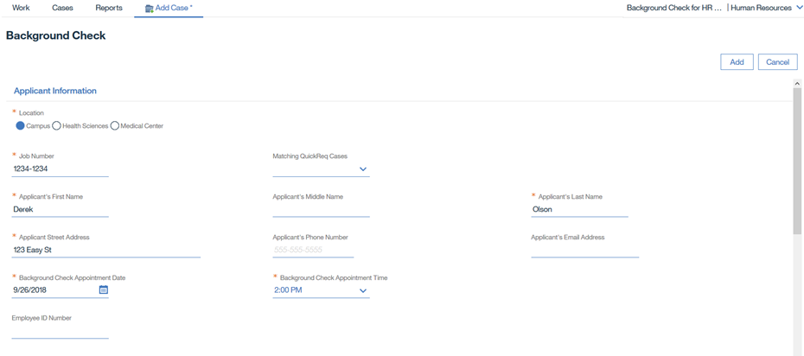
Case Manager – Background Check
Workflow
HR enters a new Background Check case:

Slide 9
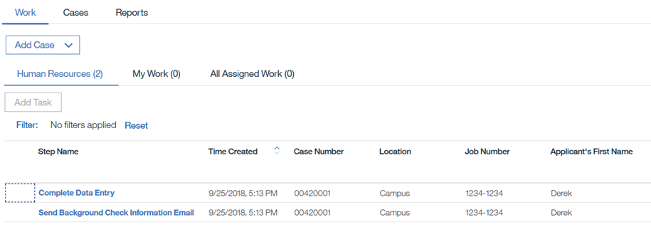
Case Manager – Background Check
Workflow
Human Resources In-Basket
The two tasks below were created automatically after the case was entered:

Slide 10
Case Manager – Background Check
Workflow
Human Resources In-Basket
The two tasks below were created automatically after the case was entered:

Slide 11
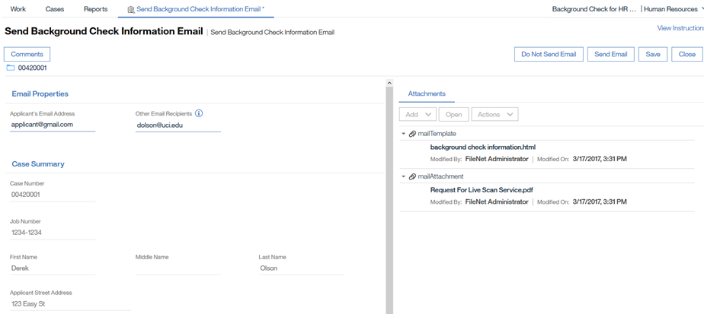
Case Manager – Background Check
Workflow
Send Background Check Information Email task (HR)

Slide 12
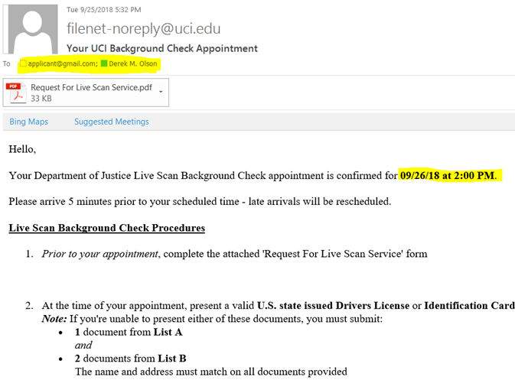
Case Manager – Background Check
Workflow
Send Background Check Information Email task (HR)

Slide 13
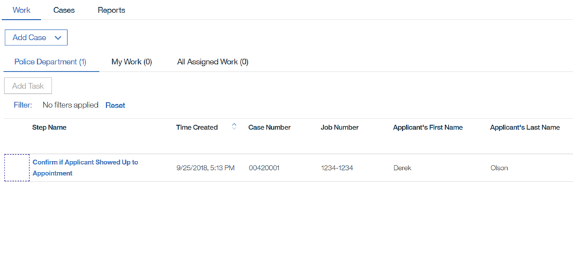
Case Manager – Background Check
Workflow
Police Department In-Basket
Example of multiple in-baskets for different roles in the case

Slide 14
Case Manager – Background Check
Workflow
Police Department In-Basket
Example of multiple in-baskets for different roles in the case

Slide 15
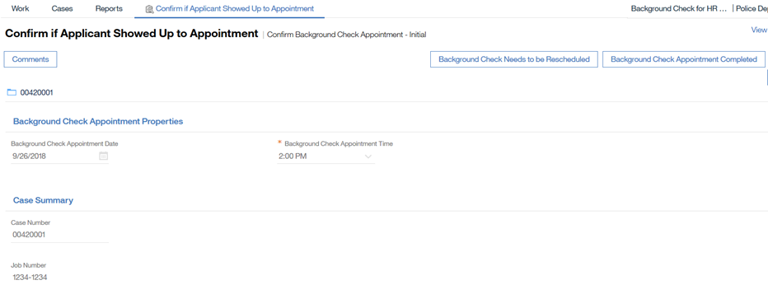
Case Manager – Background Check
Workflow
Confirm if Applicant Showed Up to Appointment Task (PD)
Business rules:
If "Background Check Needs to Be Rescheduled", a task will be created for HR to reschedule to applicant's appointment
If "Completed", a task will be created for PD to enter the results of the background check appointment.

Slide 16
Case Manager – Background Check
Workflow
Confirm if Applicant Showed Up to Appointment Task (PD)
Business rules:
If "Background Check Needs to Be Rescheduled", a task will be created for HR to reschedule to applicant's appointment
If "Completed", a task will be created for PD to enter the results of the background check appointment.

Slide 17
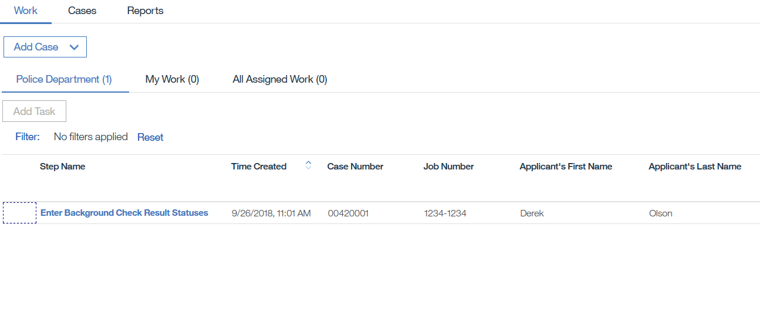
Case Manager – Background Check
Workflow
Police Department In-Basket
Enter Background Check Result Statuses task was created

Slide 18
Case Manager – Background Check
Workflow
Police Department In-Basket
Enter Background Check Result Statuses task was created

Slide 19
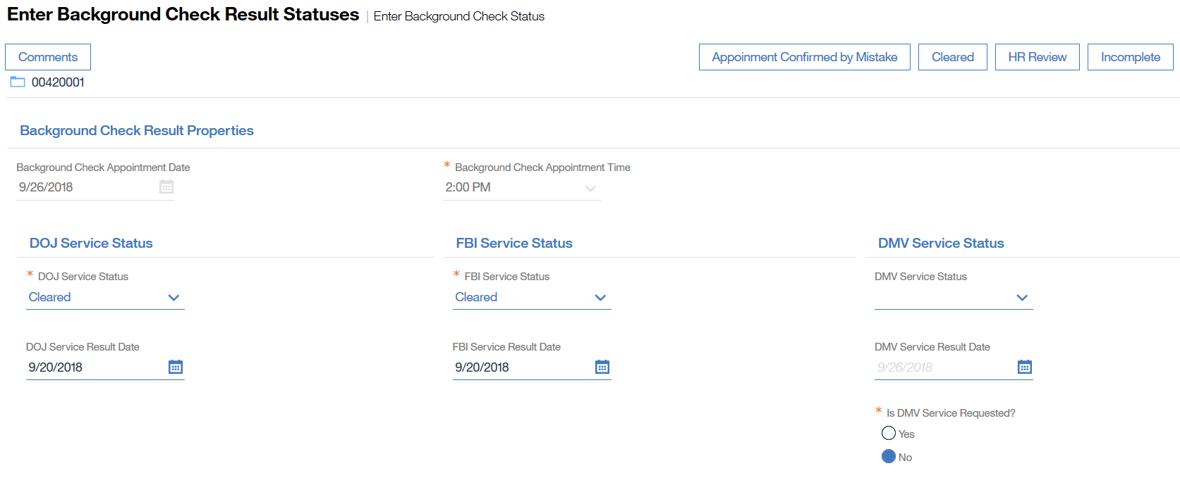
Case Manager – Background Check
Workflow
Enter Background Check Result Statuses task (PD)
Applicant is cleared

Slide 20
Case Manager – Background Check
Workflow
Enter Background Check Result Statuses task (PD)
Applicant is cleared

Slide 21
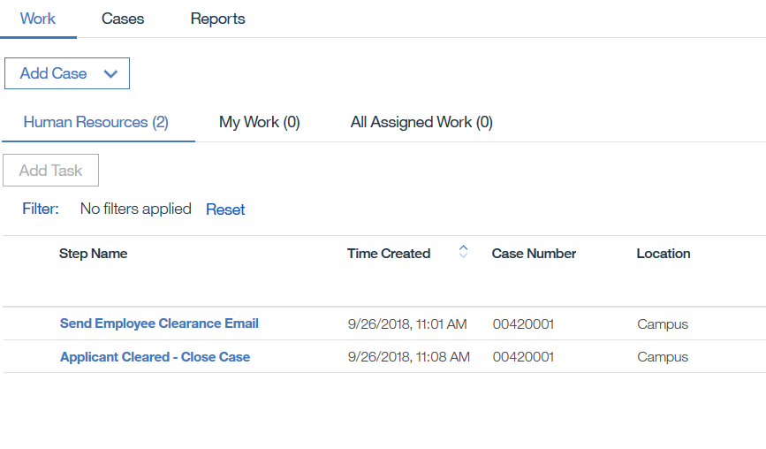
Case Manager – Background Check
Workflow
Human Resources In-Basket
Closing tasks after applicant is cleared:

Slide 22
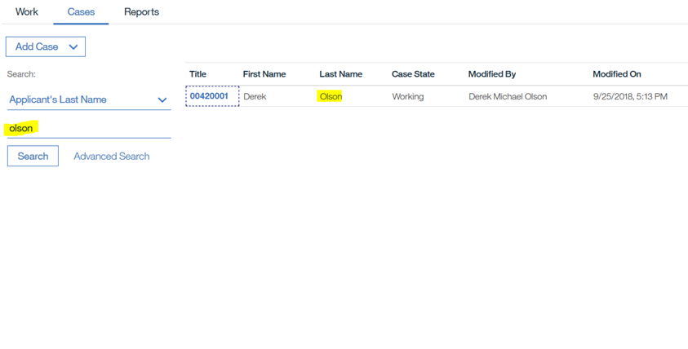
Case Manager – Background Check
Content
Managing content for a case.
Searching for entered cases:

Slide 23
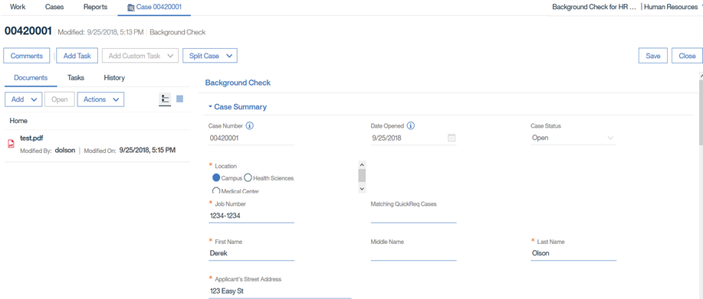
Case Manager – Background Check
Content
Adding documents:

Slide 24
Case Manager – Background Check
Content
Adding notes:

Slide 25
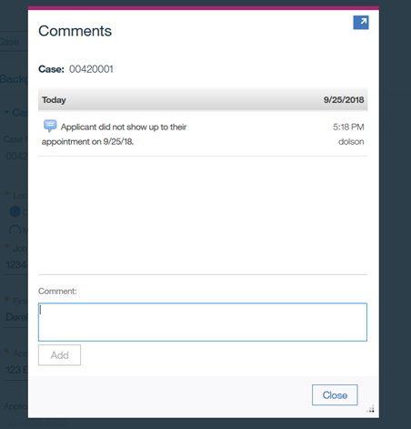
Case Manager – Background Check
Content
Adding notes:

Slide 26
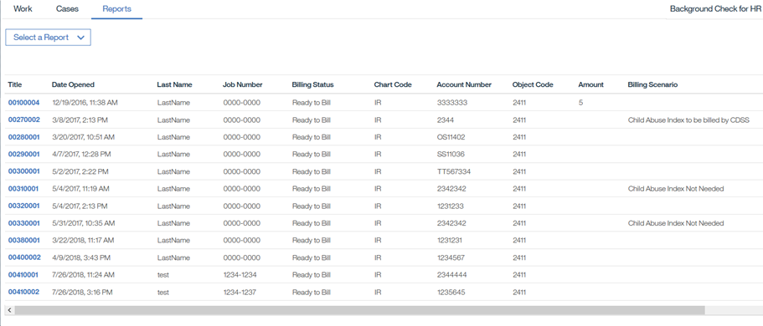
Case Manager – Background Check
Reports
Pre-built Reports by OIT developer
Or user can build their own report via Cognos
Below is a sample of the pre-built report

