Slide 1
Digital Workflows in ServiceNow
A New Way to Do Business

Slide 2
Our process isn’t working for everyone…
The current systems/processes are broken and make collaboration and communication harder then ever, leading to delays and missed SLAs
LOST PRODUCTIVITY
 | Email
“Requests are always’ lost in the inbox’” No status visibility Inconsistent updates
CUMBERSOME
 | Legacy System
“Interface is confusing and hard to use” Difficult to use Lacks transparency
HARD TO MANAGE
 | Paper Process
“I can’t seem to locate that fax…” Time consuming Lacks measurement & reporting
TIME CONSUMING
 | Spreadsheets
“The moment it’s updated it becomes obsolete and the process starts over” Manual updates Lacks real-time information
Notes:
The stated problem we are addressing:
The current systems/processes are broken and make collaboration and communication harder then ever, leading to delays and missed SLAs

Slide 3
Power of a Shared Platform: ServiceNow
OIT has created a custom application framework on the ServiceNow platform that can be redeployed to any UCI business unit/department. This application is configured and customized to each business unit/department’s needs.
IMPROVE EXPERIENCE
Enhanced User Experience and communication channels Faster Delivery using Automated workflows Improve Faster Resolution via self-service or direct customer interactions
WORKFORCE EXCELLENCE
Reduce Effort by eliminating unnecessary tasks Improve Communications by providing timely status Single System of Truth reducing the number of systems tracking data
OPTIMIZATION
Real-time Analytics through the use of timely visibility into data Risk Mitigation Reduce compliance and risk factors

Slide 4
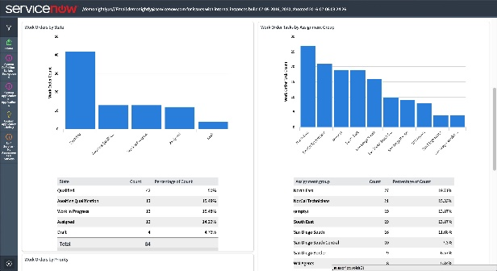
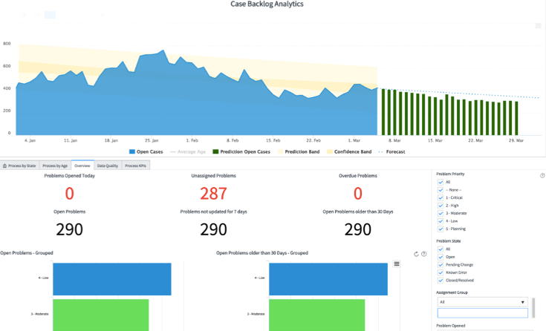
The Power of a Shared Platform
SHARED PLATFORM CAPABILITIES
REPORTING & DASHBOARDS
SHARED USER & ASSET DATA
KNOWLEDGE
SELF-SERVICE PORTAL
NOTIFICATIONS
WORKFLOW, SLAs, APPROVAL
REDUCE COSTS and time by eliminating manual consolidation of data
DRIVE BUSINESS DECISIONS utilizing real-time data
IMPROVE USER EXPERIENCE with personalized dashboards for multiple personas

Slide 5
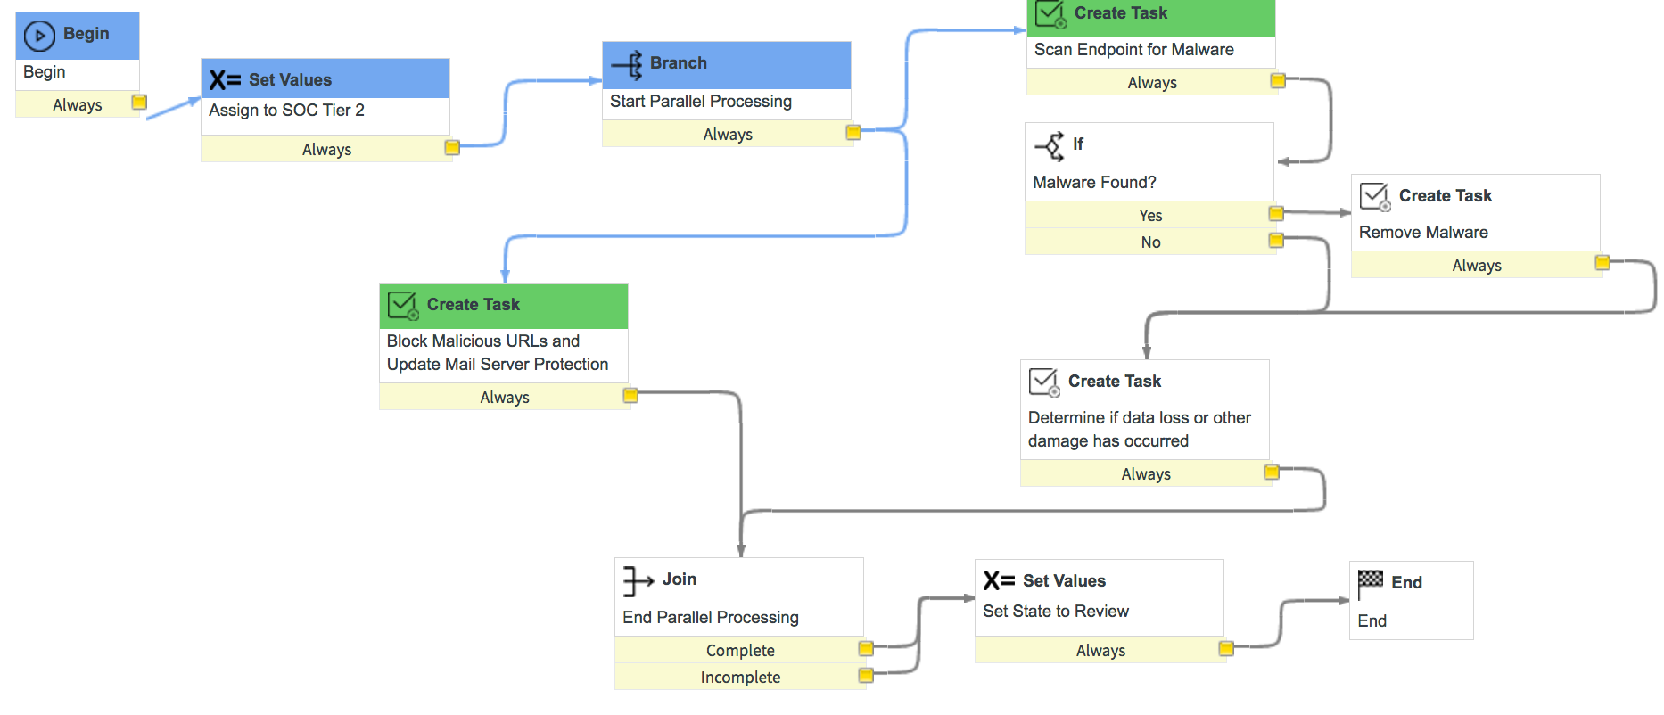
The Power of a Shared Platform
SHARED PLATFORM CAPABILITIES
REPORTING & DASHBOARDS
SHARED USER & ASSET DATA
KNOWLEDGE
SELF-SERVICE PORTAL
NOTIFICATIONS
WORKFLOW, SLAs, APPROVAL
DRIVE DECISIONS based on end-to-end data
SAVE TIME AND COST: Eliminate manual consolidation of information
POWERFUL AND FLEXIBLE API to support integration with critical systems of record
INTERGRATE with Single Sign-on Services and secure your data using access controls by IP address, by user, by role, and using multi-factor authentication
DATA ENCRYPTION at the field and table level to secure sensitive information

Slide 6
The Power of a Shared Platform
SHARED PLATFORM CAPABILITIES
REPORTING & DASHBOARDS
SHARED USER & ASSET DATA
KNOWLEDGE
SELF-SERVICE PORTAL
NOTIFICATIONS
WORKFLOW, SLAs, APPROVAL
CENTRALIZED Content-Specific Management of Categorized Content
USER ATTRIBUTE-BASED Content Creation and Editing
ENGAGING USER INTERFACE
PERSONALIZED USER EXPERIENCE

Slide 7
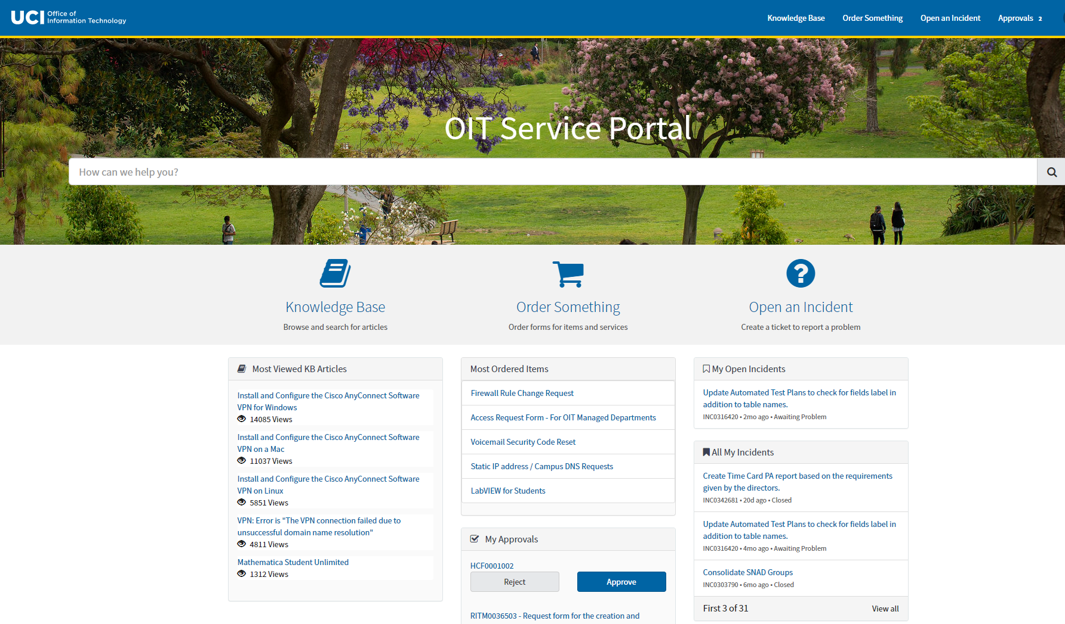
The Power of a Shared Platform
SHARED PLATFORM CAPABILITIES
REPORTING & DASHBOARDS
SHARED USER & ASSET DATA
KNOWLEDGE
SELF-SERVICE PORTAL
NOTIFICATIONS
WORKFLOW, SLAs, APPROVAL
PROVIDE CONSISTENCY to improve user experience
PROMOTE SELF-SERVICE
CONFIGURE to fit organizational needs, from reporting phishing emails or policy violations to requesting access to secure systems

Slide 8
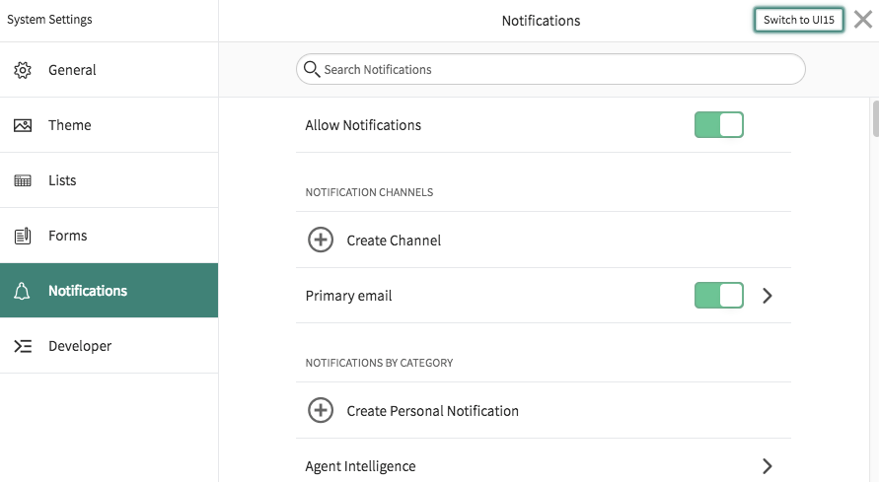
The Power of a Shared Platform
The Power of a Shared Platform
SHARED PLATFORM CAPABILITIES
REPORTING & DASHBOARDS
SHARED USER & ASSET DATA
KNOWLEDGE
SELF-SERVICE PORTAL
NOTIFICATIONS
WORKFLOW, SLAs, APPROVAL
IMPROVE EXPERIENCE:
Consistent notification process
IMPROVED PRODUCTIVITY
Empower your team to receive information in the way they want to receive it

Slide 9
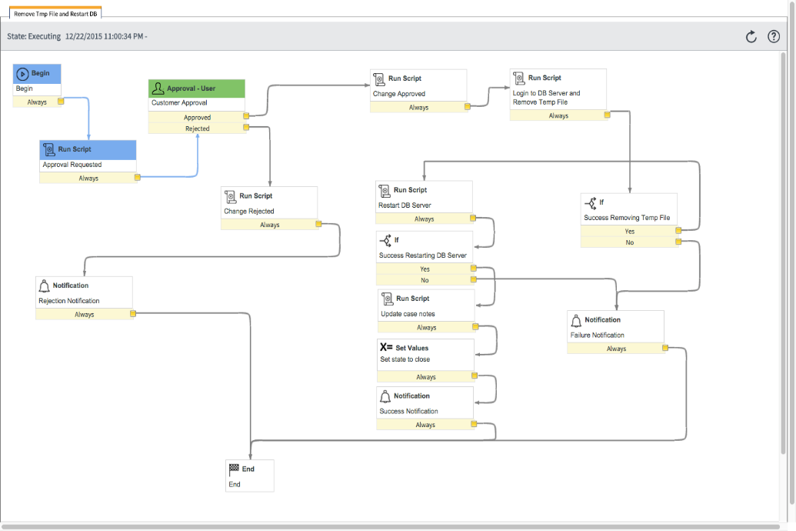
The Power of a Shared Platform
SHARED PLATFORM CAPABILITIES
REPORTING & DASHBOARDS
SHARED USER & ASSET DATA
KNOWLEDGE
SELF-SERVICE PORTAL
NOTIFICATIONS
WORKFLOW, SLAs, APPROVAL
AUTOMATE and streamline your processes
APPROVALS are intuitive for a mobile workforce
UTILIZE PERFORMANCE data to drive continuous improvement initiatives

Slide 10
Works For You
AVAILABLE ANYTIME, ANYWHERE
 | ServiceNow at UCI
IT
You
HR
RESOLVE ISSUES QUICKLY
 | Support: Help - It’s broken!
INFORMATION AT YOUR FINGERTIPS
REAL-TIME STATUS
 | Request: I want something
Knowledge
Reporting
Profile

Slide 11
Questions
COME SEE US
Booth 36
CONTACT US
Jason Dulaney
(949) 824-1032
Dulaneyj@uci.edu

