Slide 1
Give a Hoot About Reporting and Analytics!
oit.uci.edu/bi-dss/
(Decision Support Tab)
portal.uci.edu
(Decision Support Tab)
datawarehouse.uci.edu
(New Website Coming Soon!)

Slide 2
Come Watch Our Presentations!
Presentation | Location | Time #1 | Time #2
Need some data? Build a query! (DWQuery) | Moss Cove B | 11:00 am – 11:25 am | 12:30 pm – 12:55pm
Cognos I: Get the facts | Moss Cove B | 11:30 am – 11:55 am | 2:00 pm – 2:25 pm
Cognos II: Get the insight | Moss Cove B | 12:00 pm – 12:25 pm | 2:30 pm – 2:55 pm

Slide 3
Research Administration Reports

Slide 4
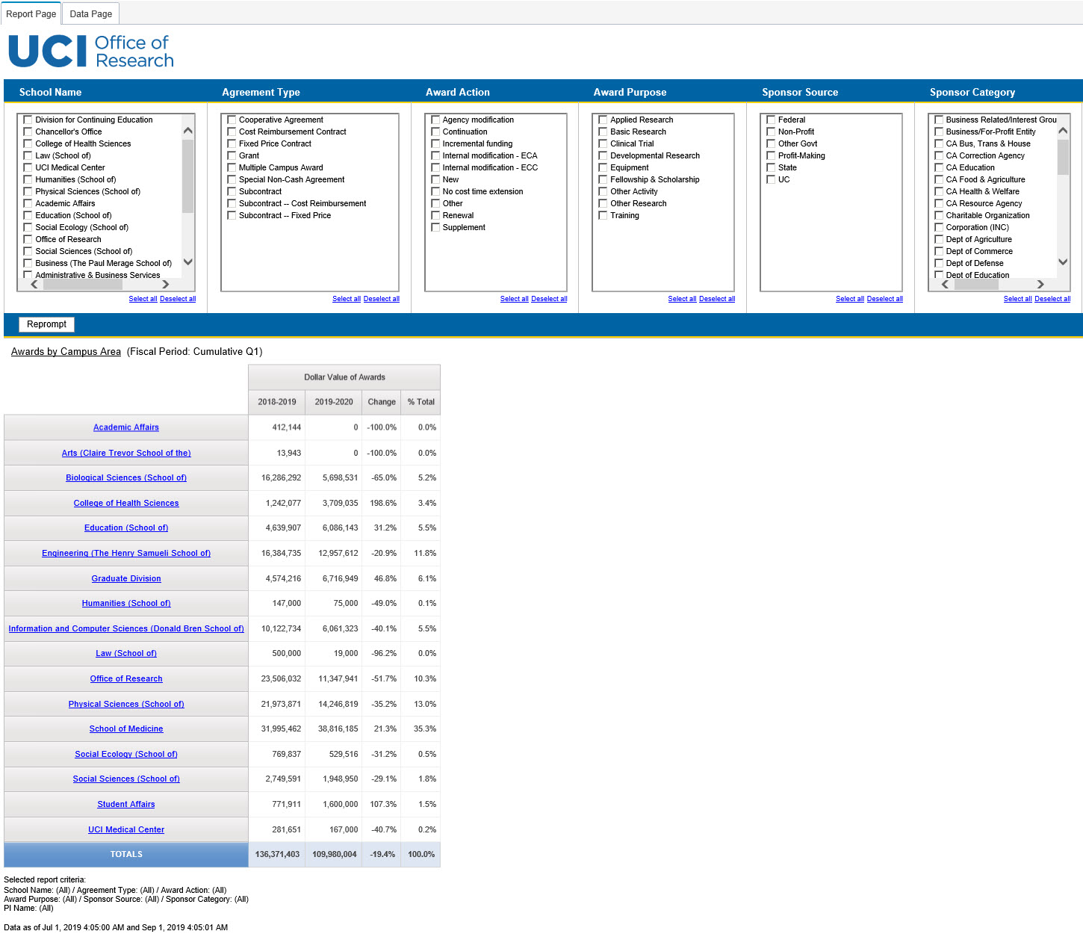
Awards by School
Click for more detail…

Slide 5
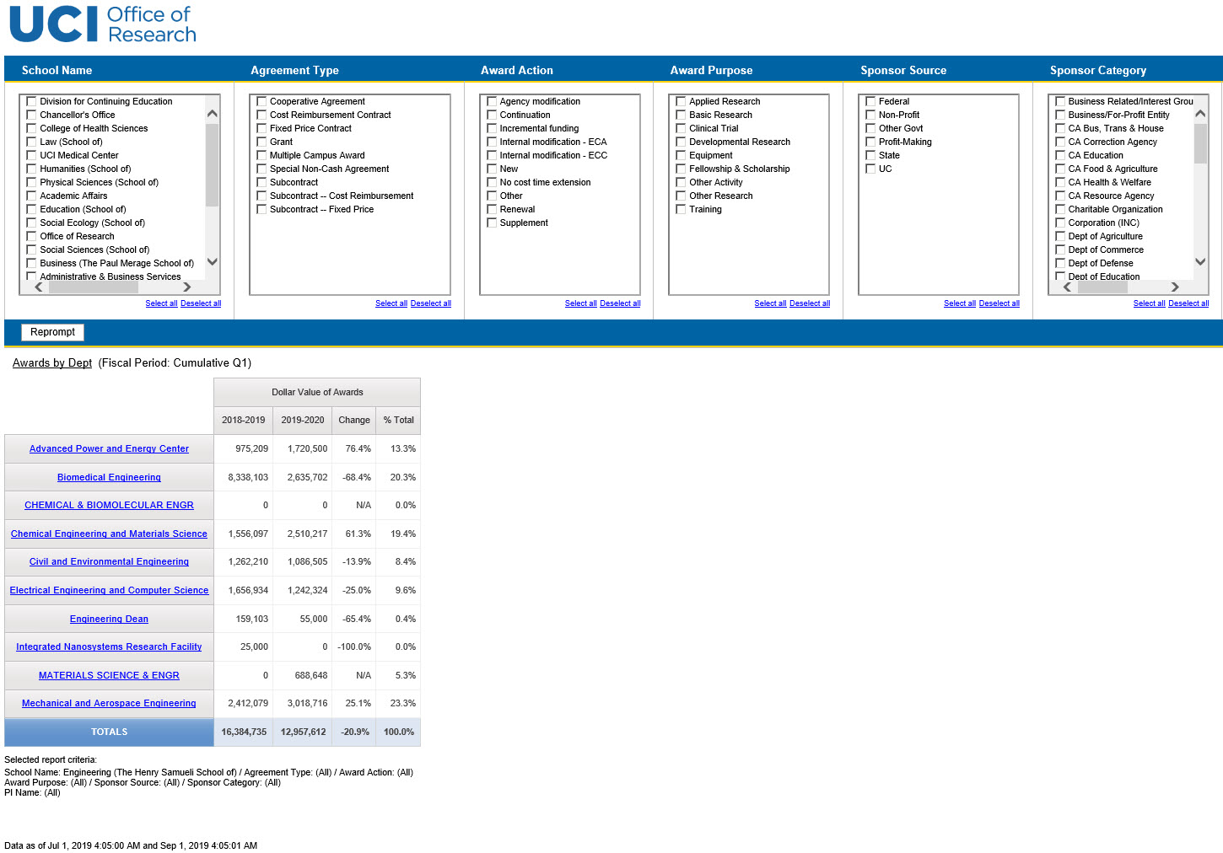
Awards by Dept
Click for more detail…

Slide 6
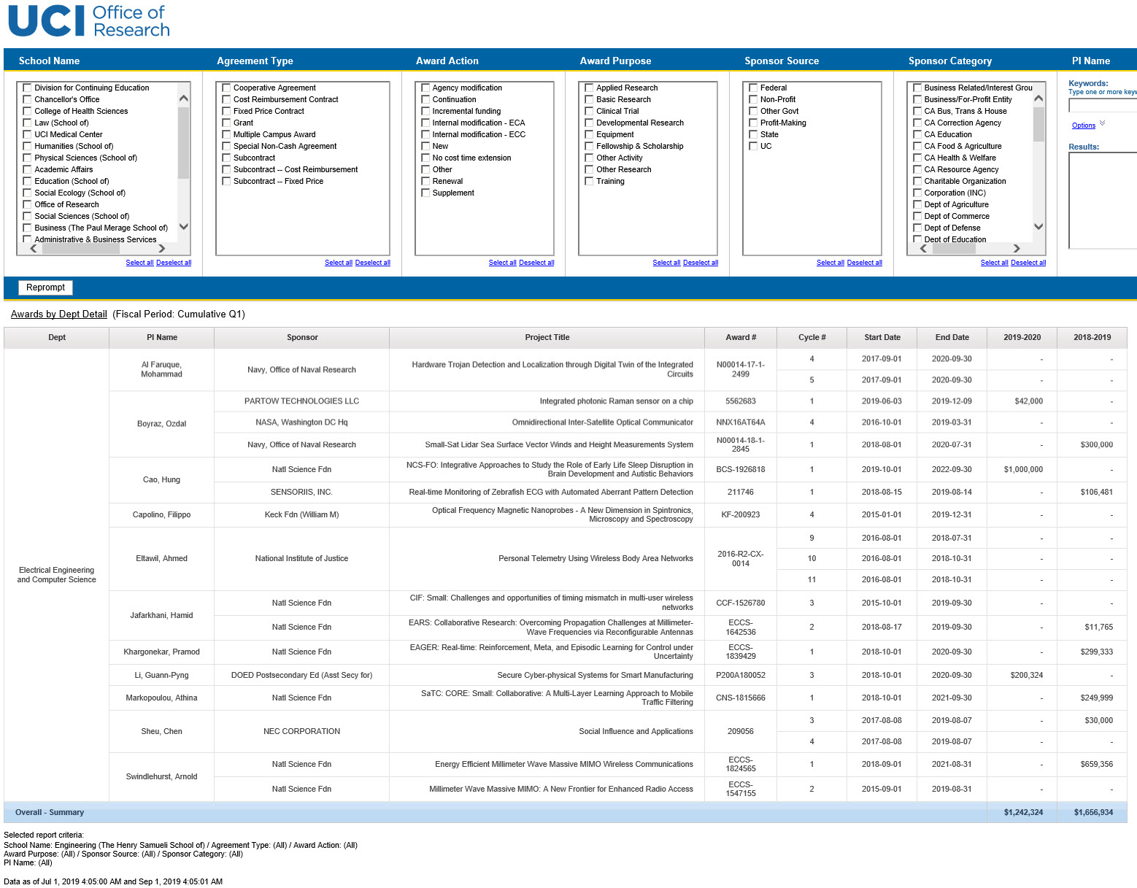
Awards by PI

Slide 7
PI/Co-PI Credit
Click for more detail…

Slide 8
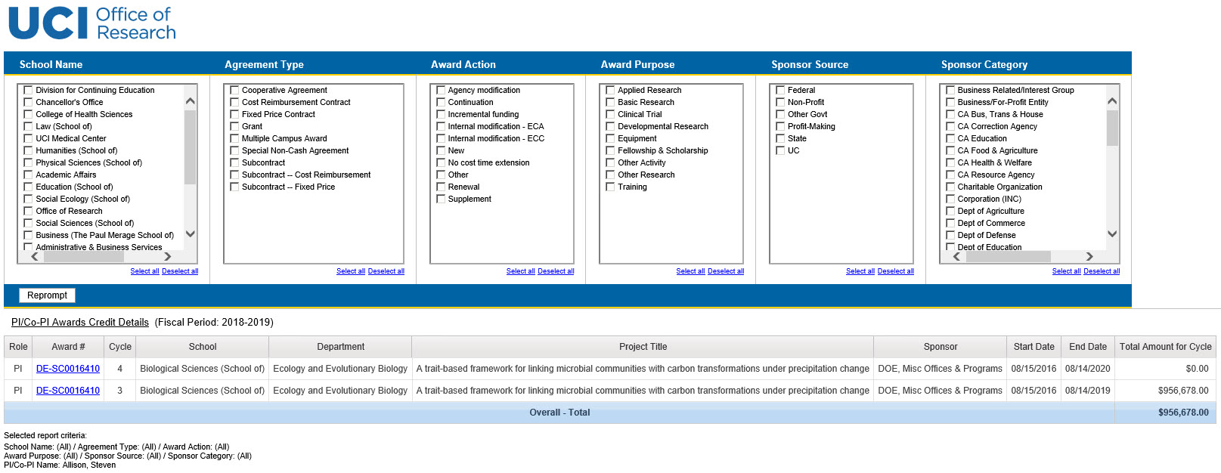
PI/Co-PI Credit Detail

Slide 9
Questions? Contact Us!
OIT Help Desk: (949) 824 – 2222 or oit@uci.edu
Data Warehouse Email List: uci-dwh@uci.edu
Cognos Email List: oit-cognos-users@uci.edu

Slide 10
Give a Hoot About Reporting and Analytics!
portal.uci.edu
(Decision Support Tab)
datawarehouse.uci.edu
(New Website Coming Soon!)

Slide 11
Come Watch Our Presentations!
Presentation | Location | Time #1 | Time #2
Need some data? Build a query! (DWQuery) | Moss Cove B | 11:00 am – 11:25 am | 12:30 pm – 12:55pm
Cognos I: Get the facts | Moss Cove B | 11:30 am – 11:55 am | 2:00 pm – 2:25 pm
Cognos II: Get the insight | Moss Cove B | 12:00 pm – 12:25 pm | 2:30 pm – 2:55 pm

Slide 12
UCPath Reports

Slide 13
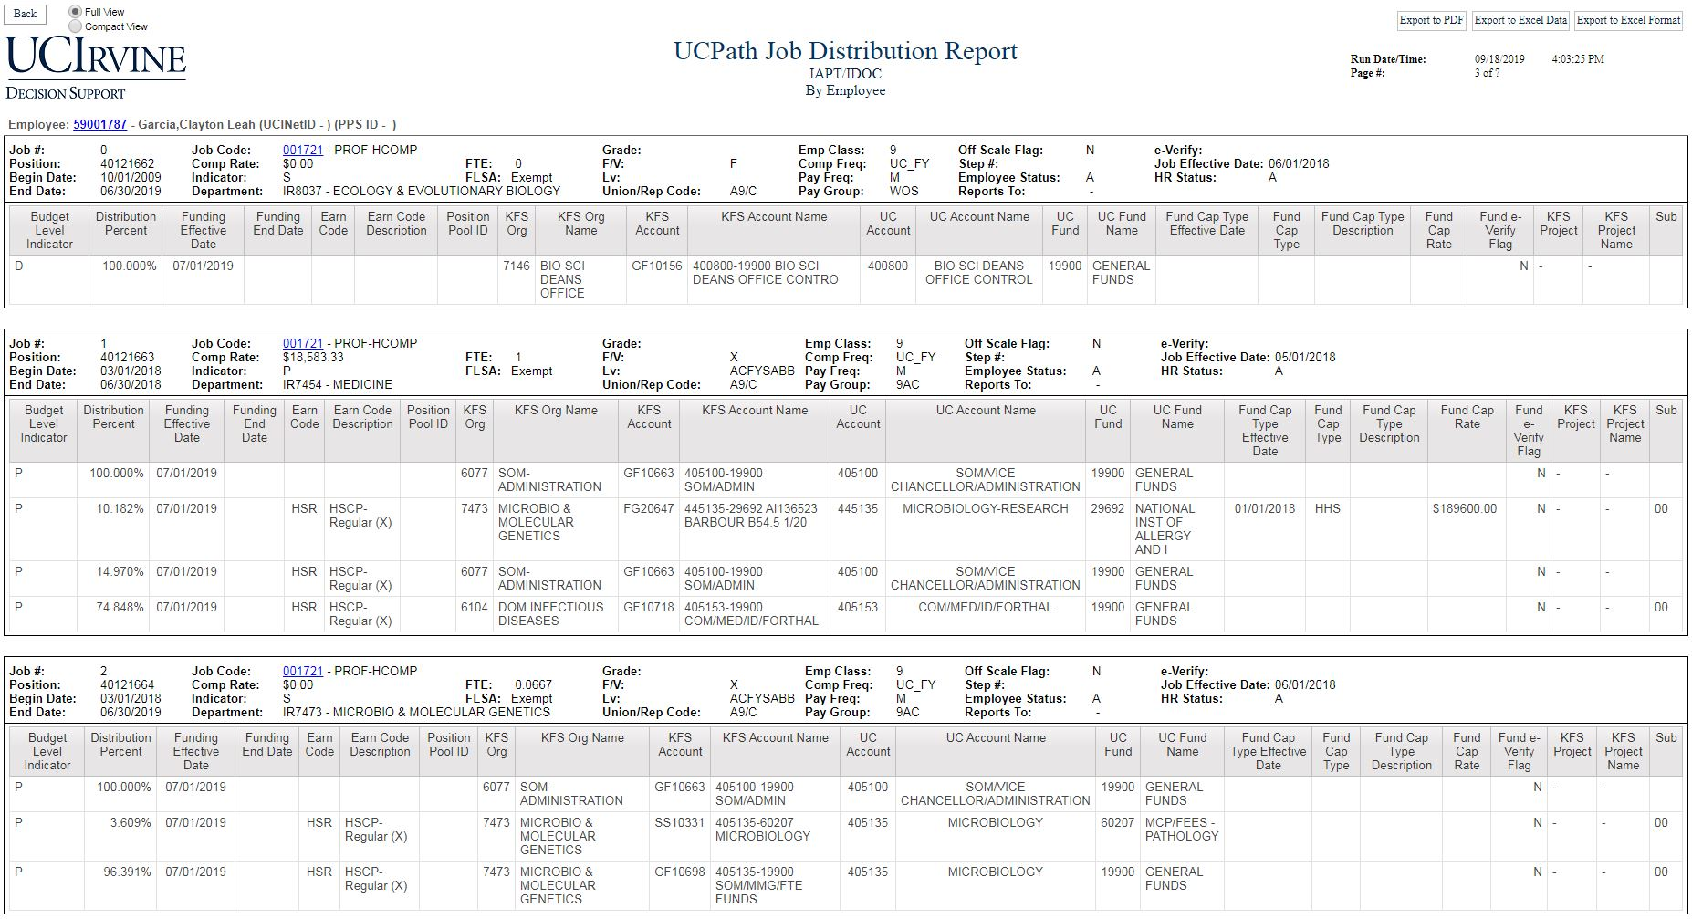

Slide 14
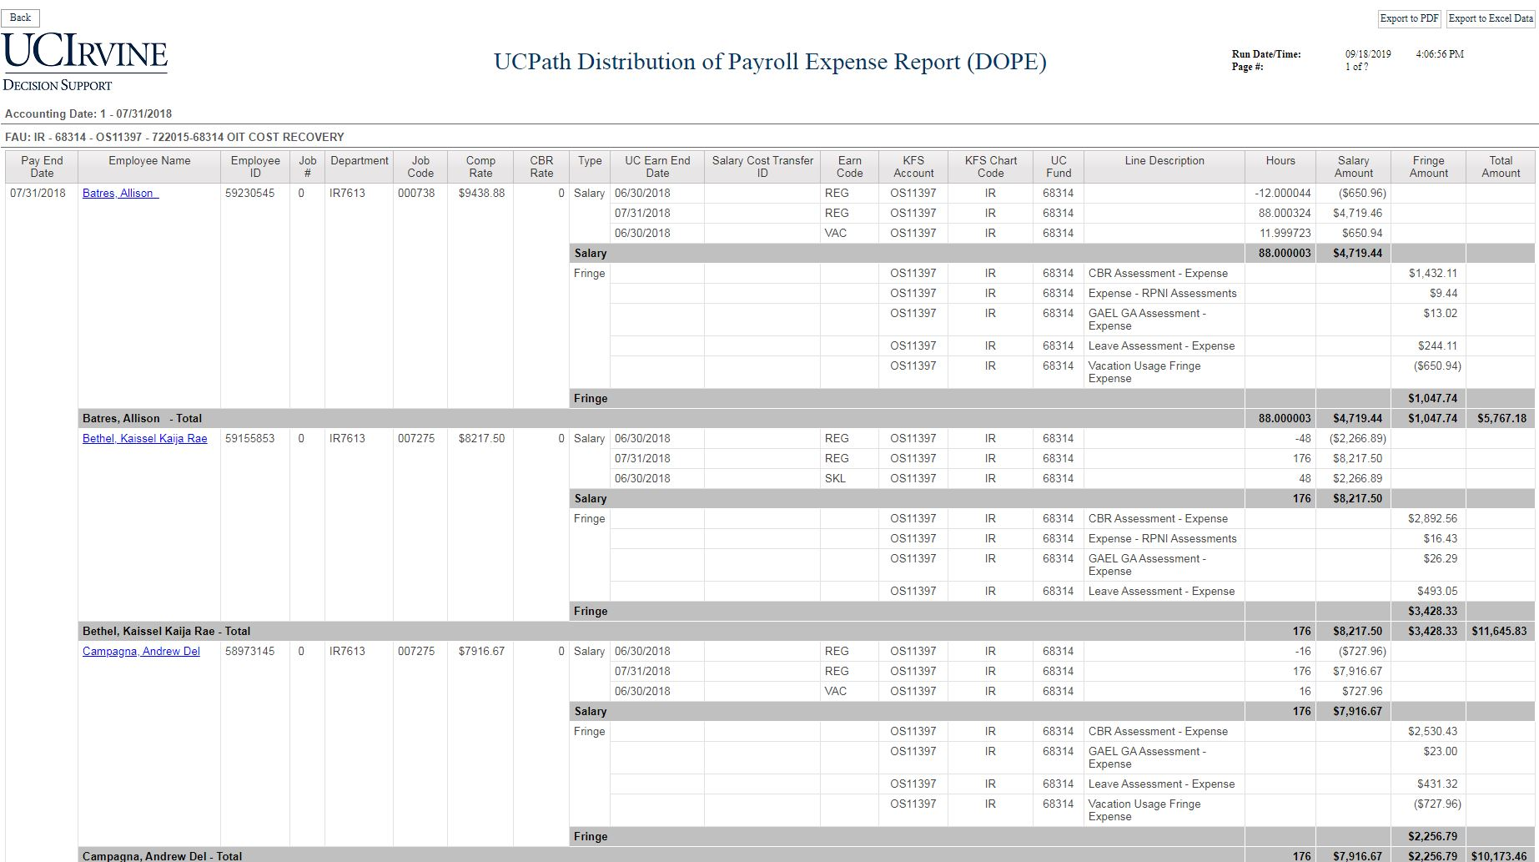

Slide 15
Questions? Contact Us!
OIT Help Desk: (949) 824 – 2222 or oit@uci.edu
Data Warehouse Email List: uci-dwh@uci.edu
Cognos Email List: oit-cognos-users@uci.edu

Slide 16
Give a Hoot About Reporting and Analytics!
portal.uci.edu
(Decision Support Tab)
datawarehouse.uci.edu
(New Website Coming Soon!)

Slide 17
Come Watch Our Presentations!
Presentation | Location | Time #1 | Time #2
Need some data? Build a query! (DWQuery) | Moss Cove B | 11:00 am – 11:25 am | 12:30 pm – 12:55pm
Cognos I: Get the facts | Moss Cove B | 11:30 am – 11:55 am | 2:00 pm – 2:25 pm
Cognos II: Get the insight | Moss Cove B | 12:00 pm – 12:25 pm | 2:30 pm – 2:55 pm

Slide 18
DWQuery

Slide 19
General Ledger Query Page

Slide 20
KFS General Ledger Query Result

Slide 21
New Queries Coming Soon!
Purchase Order Item (KFS)
Converted Queries from BLISS (Legacy Data Warehouse):
Fund Summary (pre-KFS, up to Fiscal Year 2013/2014)
Payroll Expense (PPS)
Sponsored Projects

Slide 22
Questions? Contact Us!
OIT Help Desk: (949) 824 – 2222 or oit@uci.edu
Data Warehouse Email List: uci-dwh@uci.edu
Cognos Email List: oit-cognos-users@uci.edu

Slide 23
Give a Hoot About Reporting and Analytics!
portal.uci.edu
(Decision Support Tab)
datawarehouse.uci.edu
(New Website Coming Soon!)

Slide 24
Come Watch Our Presentations!
Presentation | Location | Time #1 | Time #2
Need some data? Build a query! (DWQuery) | Moss Cove B | 11:00 am – 11:25 am | 12:30 pm – 12:55pm
Cognos I: Get the facts | Moss Cove B | 11:30 am – 11:55 am | 2:00 pm – 2:25 pm
Cognos II: Get the insight | Moss Cove B | 12:00 pm – 12:25 pm | 2:30 pm – 2:55 pm

Slide 25
KFS Reports

Slide 26
Award Balance Overview

Slide 27
Ledger Reconciliation Report - Prompt Page

Slide 28
Ledger Reconciliation Report

Slide 29
Questions? Contact Us!
OIT Help Desk: (949) 824 – 2222 or oit@uci.edu
Data Warehouse Email List: uci-dwh@uci.edu
Cognos Email List: oit-cognos-users@uci.edu

Slide 30
Give a Hoot About Reporting and Analytics!
portal.uci.edu
(Decision Support Tab)
datawarehouse.uci.edu
(New Website Coming Soon!)

Slide 31
Come Watch Our Presentations!
Presentation | Location | Time #1 | Time #2
Need some data? Build a query! (DWQuery) | Moss Cove B | 11:00 am – 11:25 am | 12:30 pm – 12:55pm
Cognos I: Get the facts | Moss Cove B | 11:30 am – 11:55 am | 2:00 pm – 2:25 pm
Cognos II: Get the insight | Moss Cove B | 12:00 pm – 12:25 pm | 2:30 pm – 2:55 pm

Slide 32
OIR - Student Enrollment Reports

Slide 33
OIR - Student Enrollment

Slide 34
OIR - Student Enrollment Visualization

Slide 35
Questions? Contact Us!
OIT Help Desk: (949) 824 – 2222 or oit@uci.edu
Data Warehouse Email List: uci-dwh@uci.edu
Cognos Email List: oit-cognos-users@uci.edu

Slide 36
Give a Hoot About Reporting and Analytics!
portal.uci.edu
(Decision Support Tab)
datawarehouse.uci.edu
(New Website Coming Soon!)

Slide 37
Come Watch Our Presentations!
Presentation | Location | Time #1 | Time #2
Need some data? Build a query! (DWQuery) | Moss Cove B | 11:00 am – 11:25 am | 12:30 pm – 12:55pm
Cognos I: Get the facts | Moss Cove B | 11:30 am – 11:55 am | 2:00 pm – 2:25 pm
Cognos II: Get the insight | Moss Cove B | 12:00 pm – 12:25 pm | 2:30 pm – 2:55 pm

